Slide 1
Basics of Wearable Electronics
Dinesh Auti

Slide 2
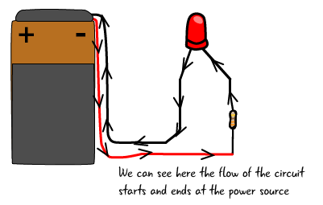
What is a Circuit?
Combination of electronic parts, wires connected between power sources. It's like a physical program. It's also like setting up dominoes in sequence.

Slide 3
LEDs
“Blinky, Festive, Elegant”

Slide 4
What is an LED?
LEDs (that’s “ell-ee-dees”) are a particular type of diode that convert electrical energy into light. In fact, LED stands for “Light Emitting Diode.” (It does what it says on the tin!)

Slide 5
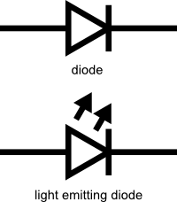
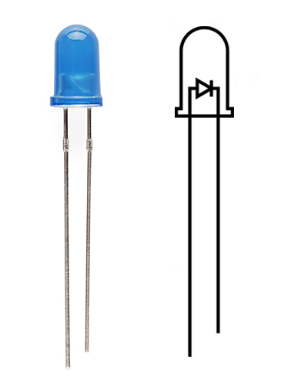
Basics
Ohms Law
LEDs require a lot less power to light up
Polarity matters
More current equals More light
There is such a thing as too much power!

Slide 6
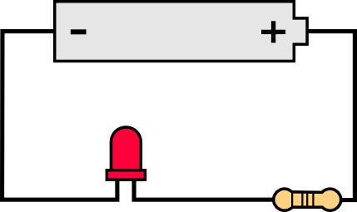
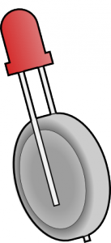
LEDs without Maths
A rule of thumb
A battery, a resistor and an LED
A good resistor value for most LEDs is 330 Ohms
Connect all the components in series as shown
Another way to light up an LED is to just connect it to a coin cell battery!

Slide 7
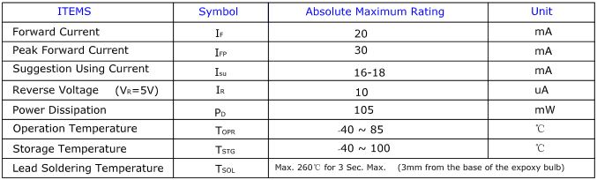
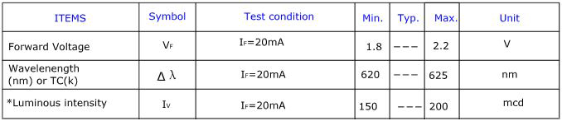
LEDs with Maths
Of course, if you’re not getting great results with the trial and error approach, you can always get out your calculator and math it up.
LED Current
LED Voltage
LED Wavelength
LED Brightness

Slide 8
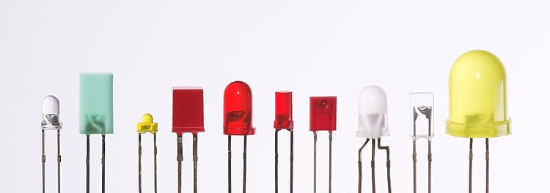

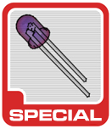


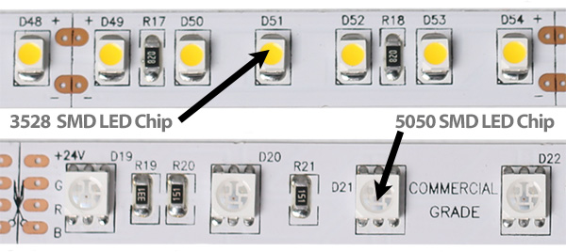
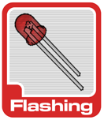

Slide 9
Demo!

Slide 10
Battery
“The Power!”

Slide 11
What is a Battery?
Imagine a world where everything that used electricity had to be plugged in
Battery to our rescue
Chemical to Electrical
Potential difference and Current
With great power comes great responsibility!
How Long Will My Project Run on Battery Power?
Battery capacity is given in milliamp-hours (mAh)

Slide 12
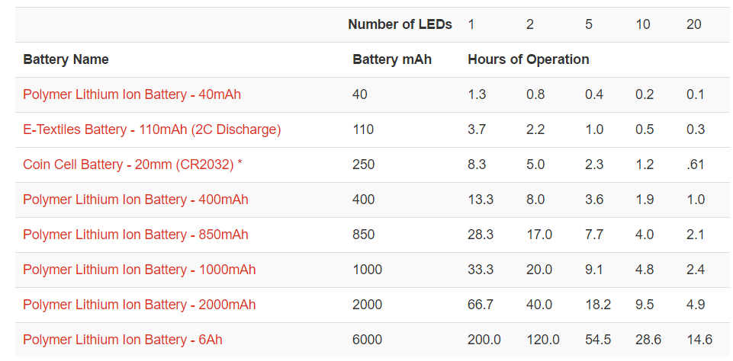
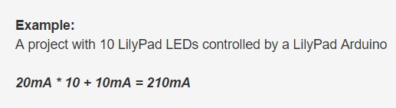
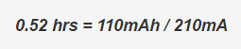
Battery Capacity
A typical LilyPad LED uses 20mA of current at full brightness
A single LilyPad Pixel Board will use 40mA when it’s set to white (all three internal LEDs fully on)
Always consider the worst case!
Hours = Battery mAh / Project mA
Example - 110mAh battery - total hours?

Slide 13
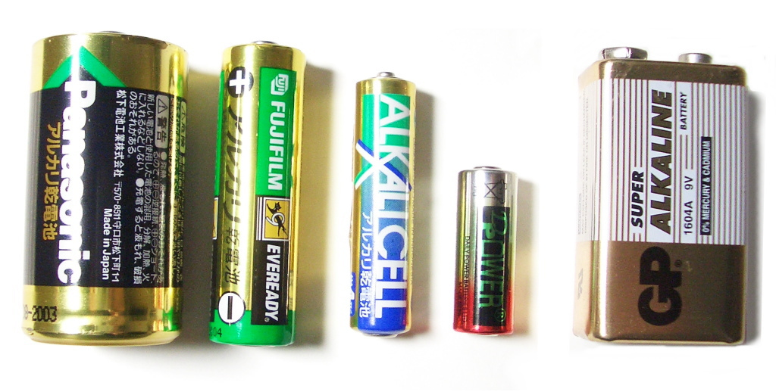
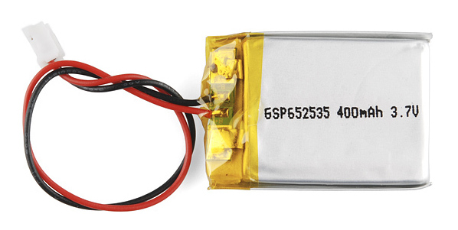
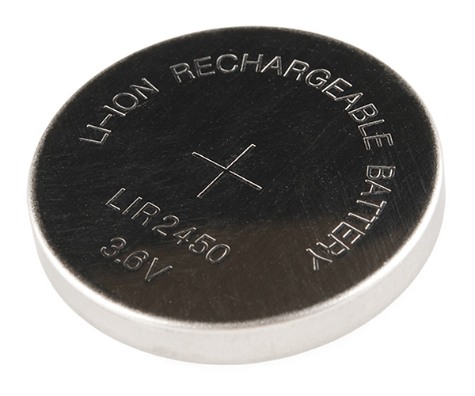

Slide 14
Controller
“The Brain”

Slide 15
What is a Controller?
Acts as the brain
Imparts smartness
Entire computer on a single chip
GPIO interface to the physical world
Transducers/Sensors
Need to write the software

Slide 16
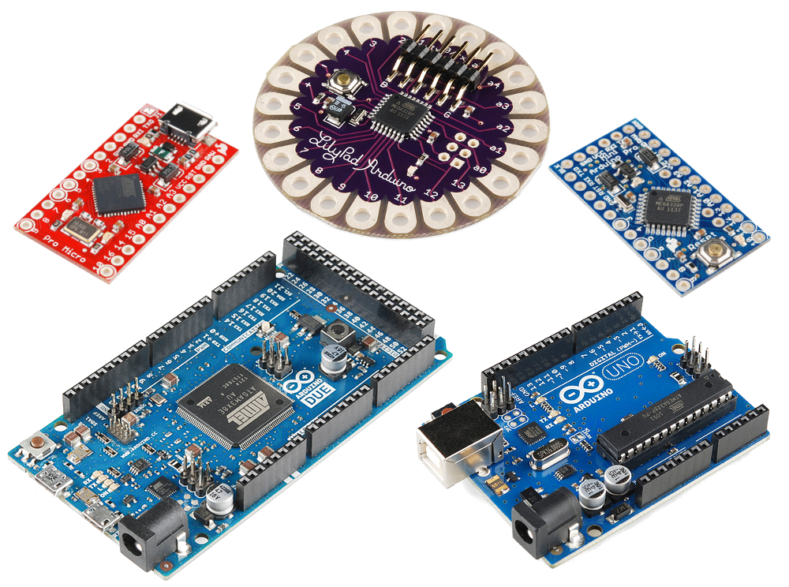

Slide 17
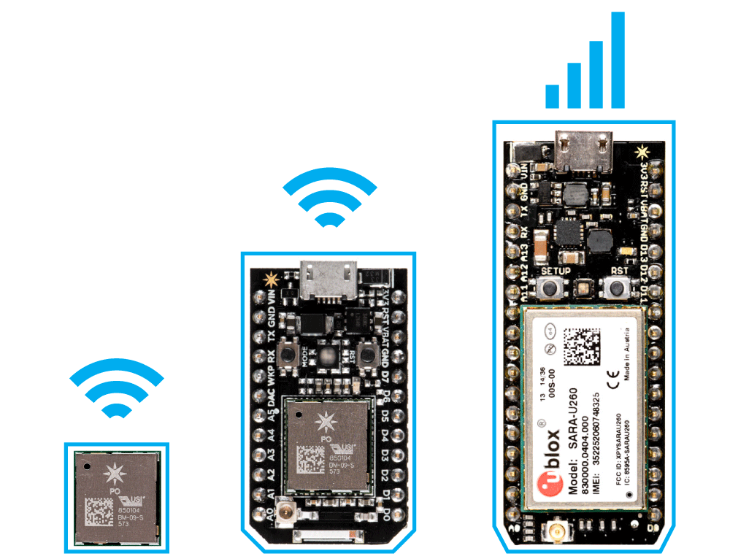
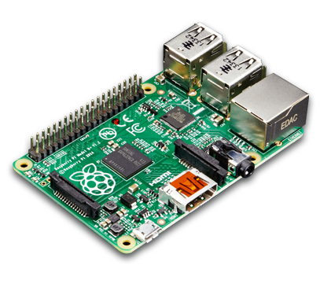

Slide 18
Demo!

Slide 19
Wearables
“Fashion meets Tech”

Slide 20
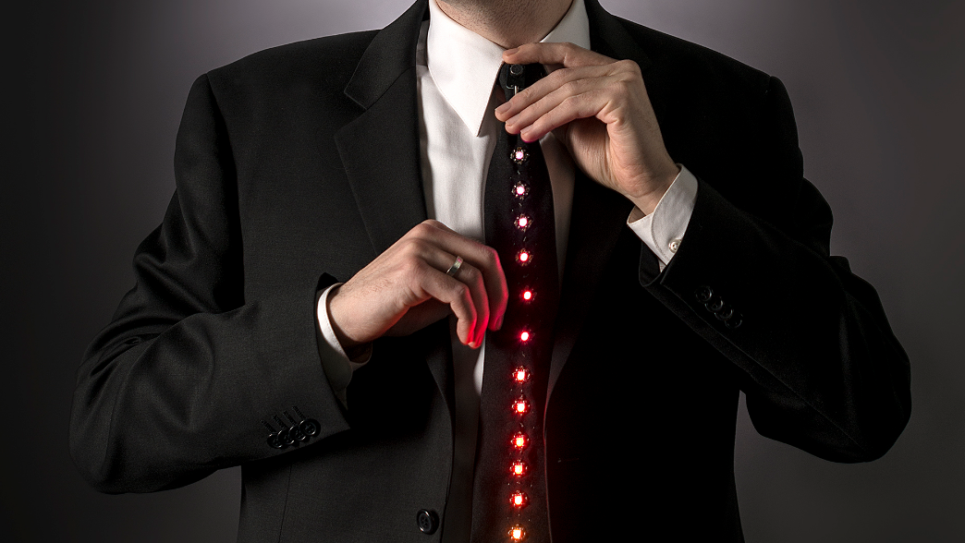

Slide 21
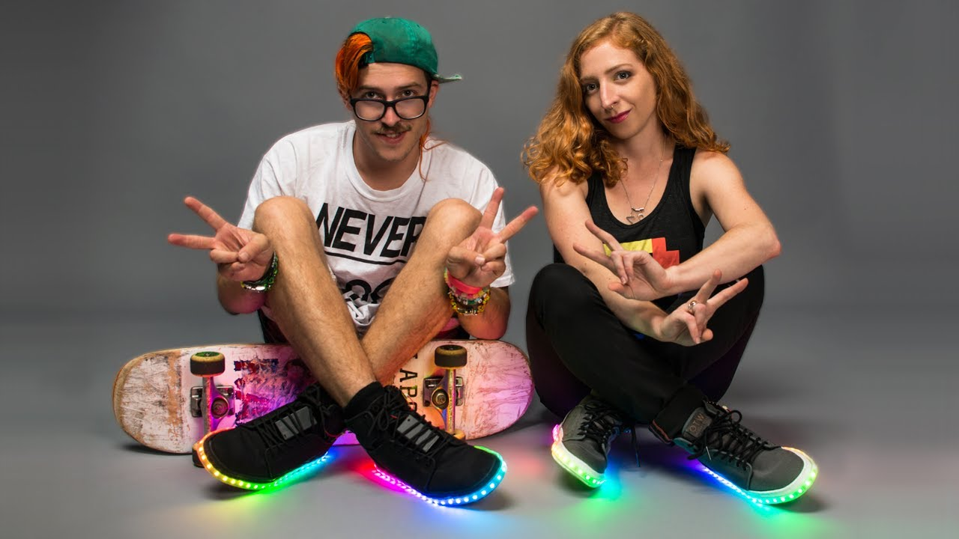

Slide 22
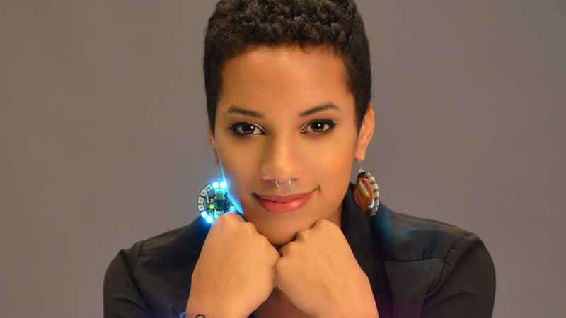

Slide 23
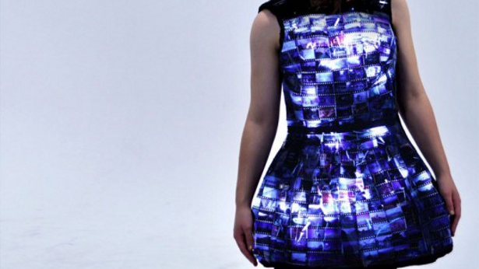

Slide 24
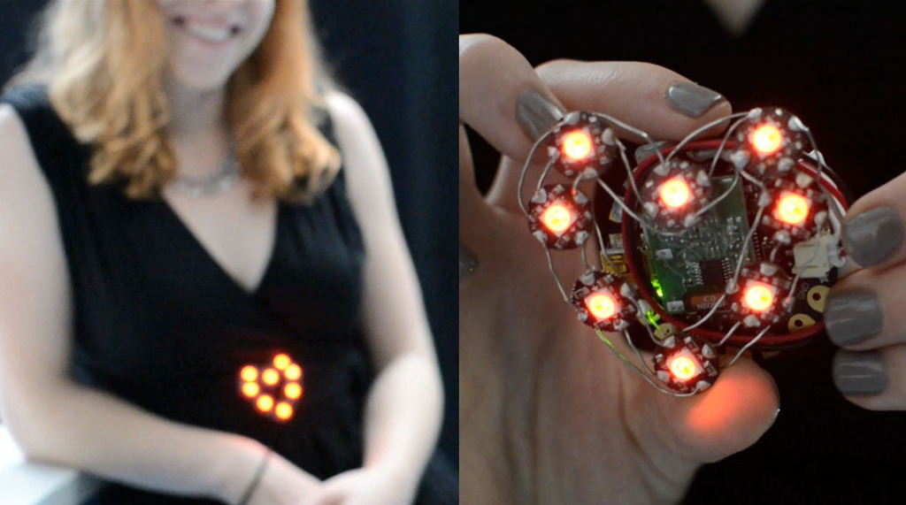

Slide 25
Demo!

Slide 26
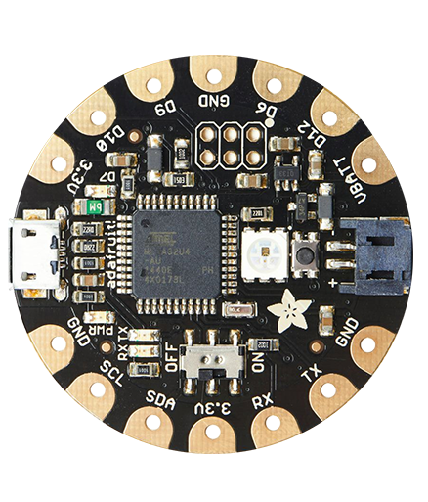
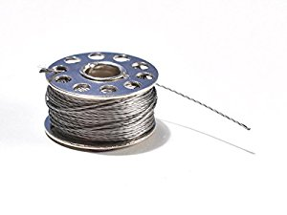
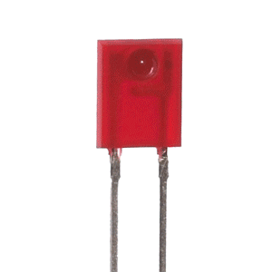

Slide 27
Credits
The content used to prepare these slides was taken from SparkFun and Adafruit.

